Slide 1

FLEETCOR CROSS-SELL STRATEGY ENHANCEMENT
Driving Success Through Innovative Solutions

Slide 2


INTRODUCTION
OBJECTIVE: OPTIMIZE THE UNIVERSAL CARD PROGRAM BY
Identifying high-value customers ("Swap-In")
Removing underperforming customers ("Swap-Out")
Solution: Implementation of a Random Forest Model for enhanced predictive accuracy and decision-making

Slide 3

WHY RANDOM FOREST?
EXCEPTIONAL PREDICTIVE ACCURACY
HANDLES COMPLEX RELATIONSHIPS:
Achieved an AUC (Area Under Curve) of 1
Captures non-linear interactions, e.g., between CREDIT_LIMIT and VANTAGE_SCORE.

Slide 4
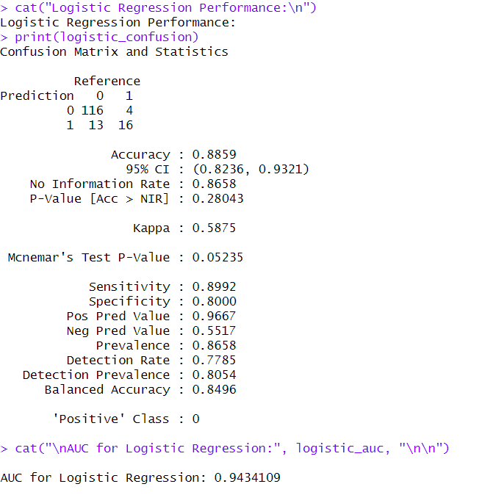
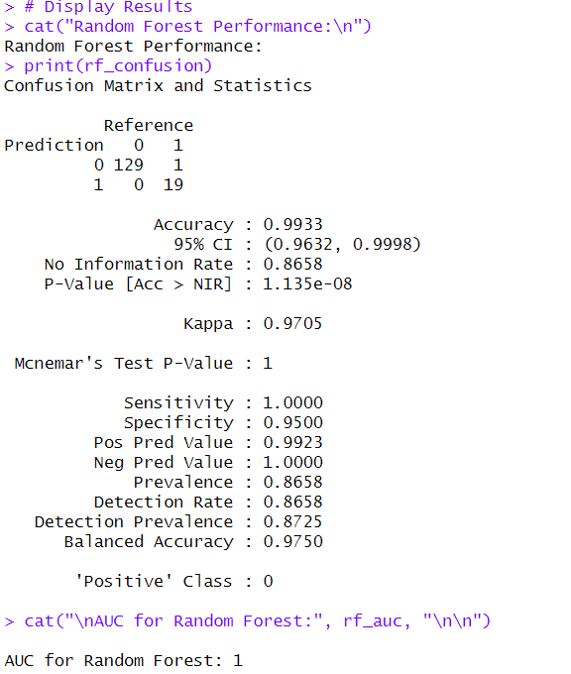

Slide 5
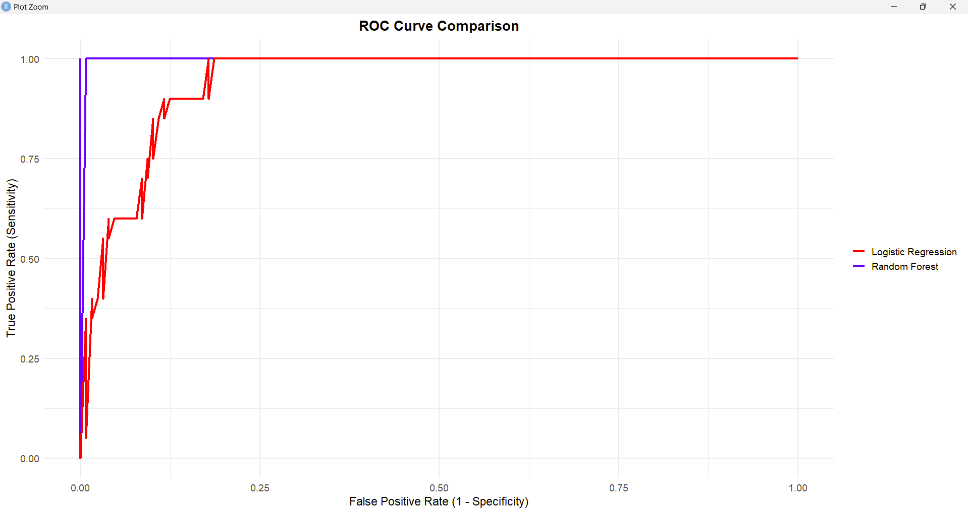

Slide 6



MODEL ANALYSIS AND RESULTS
1.
2.
3.
High Sensitivity:
Effectively classifies eligible and ineligible customers.
Balanced Accuracy:
Achieved 99.33% predictive accuracy
Insights:
CREDIT_LIMIT is the most influential factor in determining customer eligibility

Slide 7

PRACTICAL IMPLEMENTATION STEPS
1
2
3
4
MODEL DEPLOYMENT
ONGOING MAINTENANCE
STAKEHOLDER VISUALIZATION
USER ACCESSIBILITY
Save and integrate the trained model into FleetCor’s CRM system for real-time scoring.
Regular retraining with updated customer data for sustained accuracy
Tableau dashboards for performance monitoring and actionable insights.
Develop a user-friendly CRM interface for seamless access by non-technical staff

Slide 8

CONCLUSION
The Random Forest model is a reliable, high-accuracy solution for enhancing FleetCor’s cross-sell strategy.
It ensures efficient customer segmentation, improves decision-making, and minimizes risks.
Key success enablers:
System integration.
Regular model updates.
Stakeholder-centric visualizations.

Slide 9


LET'S
WORK
TOGETHER
THANK YOU!

